Slide 1
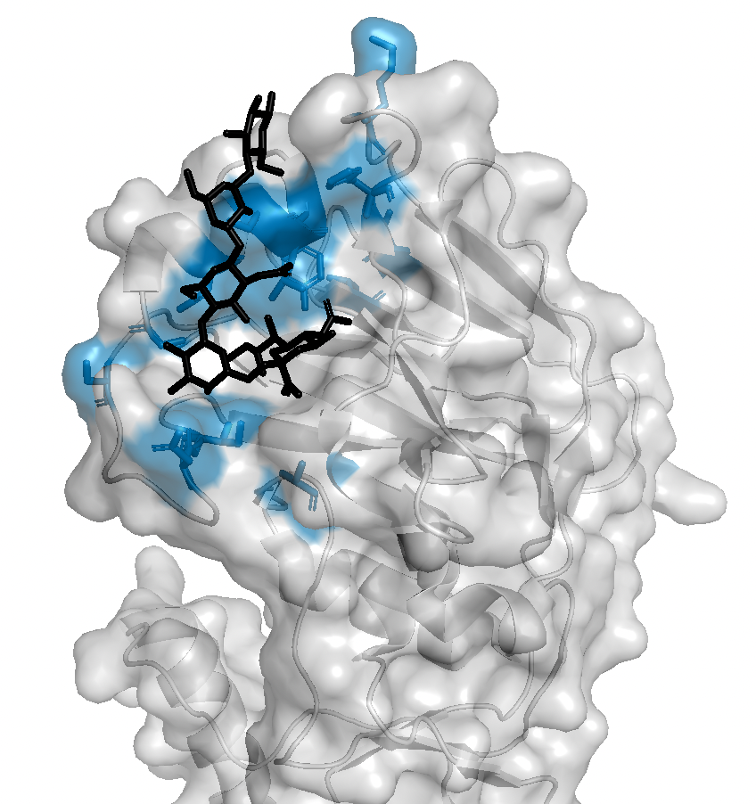
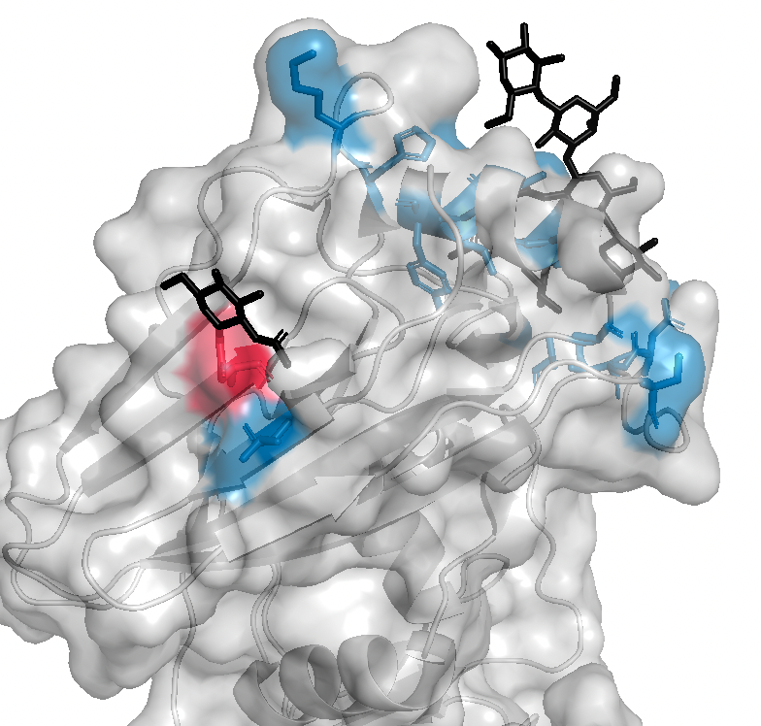
H3N2 HA monomer with 2,6-SA analog
All egg-adaptive muts identified surround the receptor binding pocket
flip
Except 246H|K|S|T
and 203I
H3n2_246glycan.pse (2YP4)

Slide 2
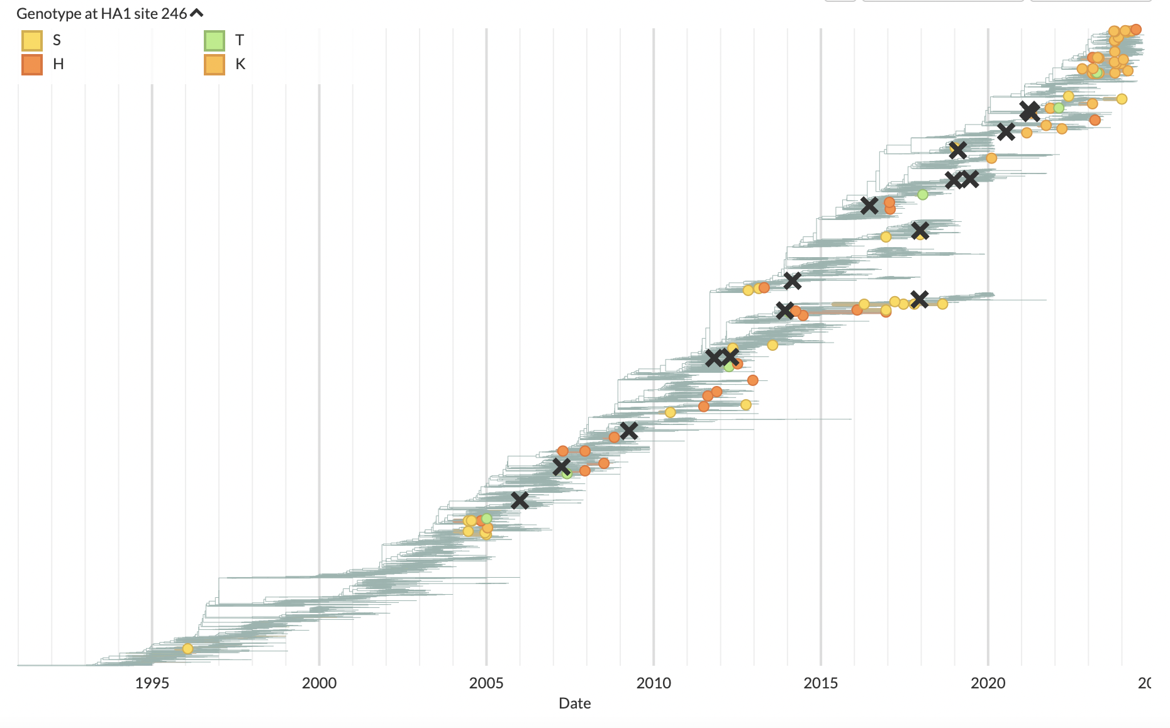
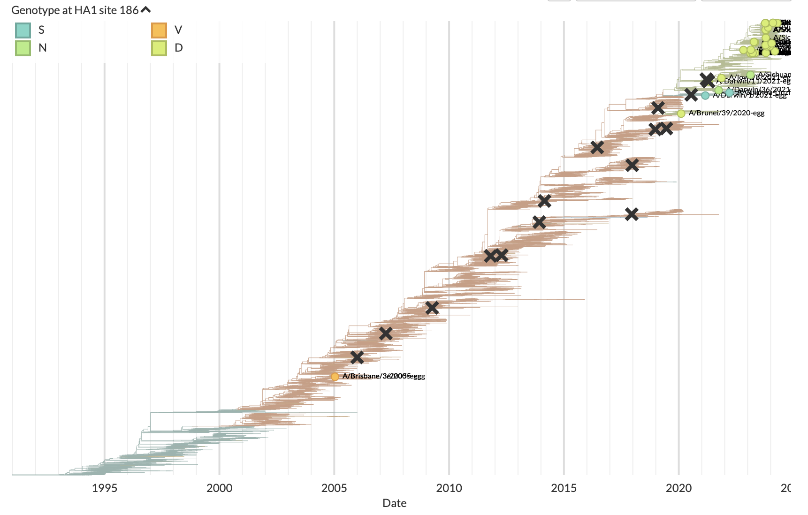
In humans, 246 is always N, and is glycosylated
In eggs, we see mutations to H,K,S,T (which would abolish glycosylation)
- Is there a chance the glycan would interfere with 2,3 but not 2,6 SA binding?
- Alt: could be lack of selection to retain glycan? Or active selection against glycan for another reason (stability?)?
- 160T is glycosylated and mutates back to 160K in eggs, though I’m not aware of any paper showing why the glycan is maladaptive
246K only happens in 2020-2024 strains (w/ exception of 1 strain)
- Not because of codon accessibility - Correlates w/ 186 != G (D,V,S,N) and 193S
- G186V known to impact shape of RBS (https://pmc.ncbi.nlm.nih.gov/articles/PMC6579542/)
- Why preference for 246K in only certain backgrounds if it’s just getting rid of a glycan?
Tips with 246K highlighted

Slide 3
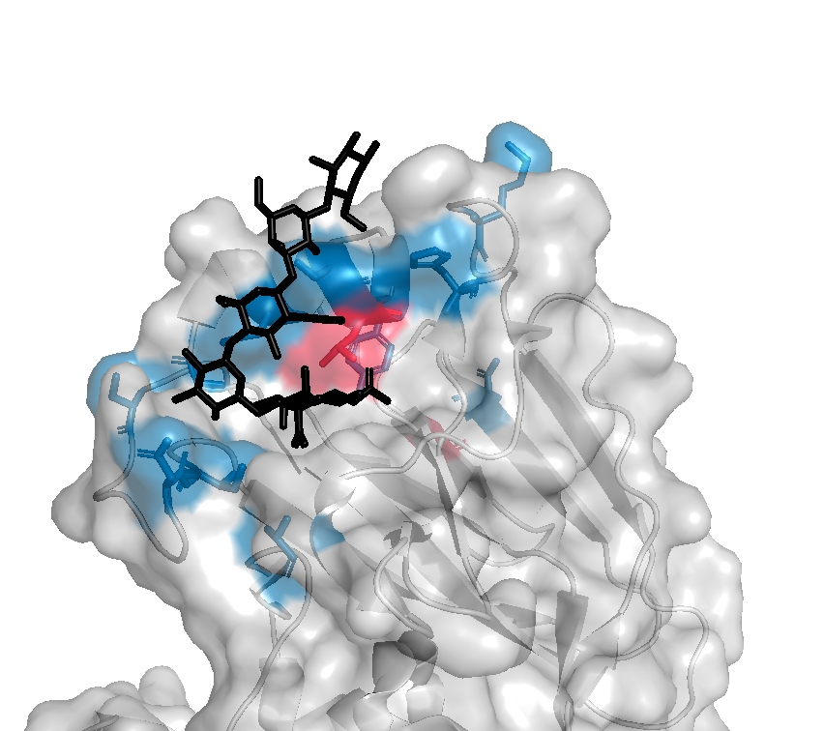
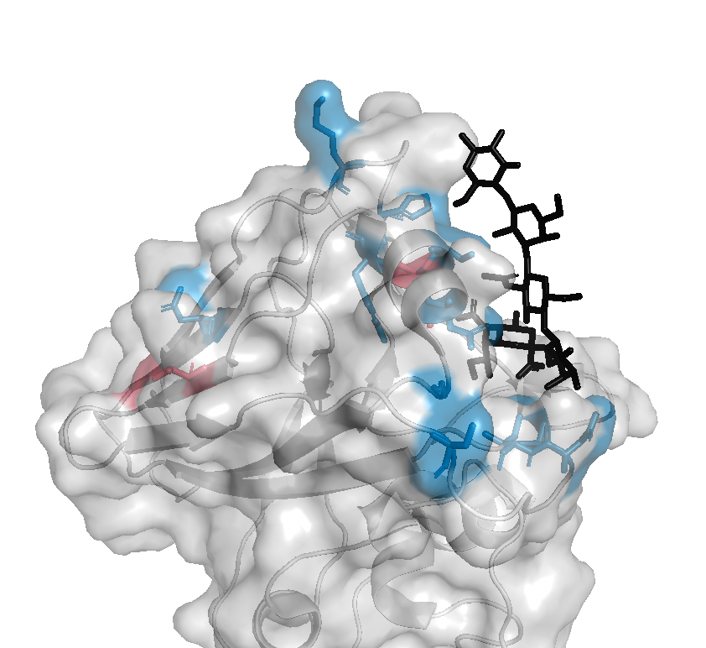
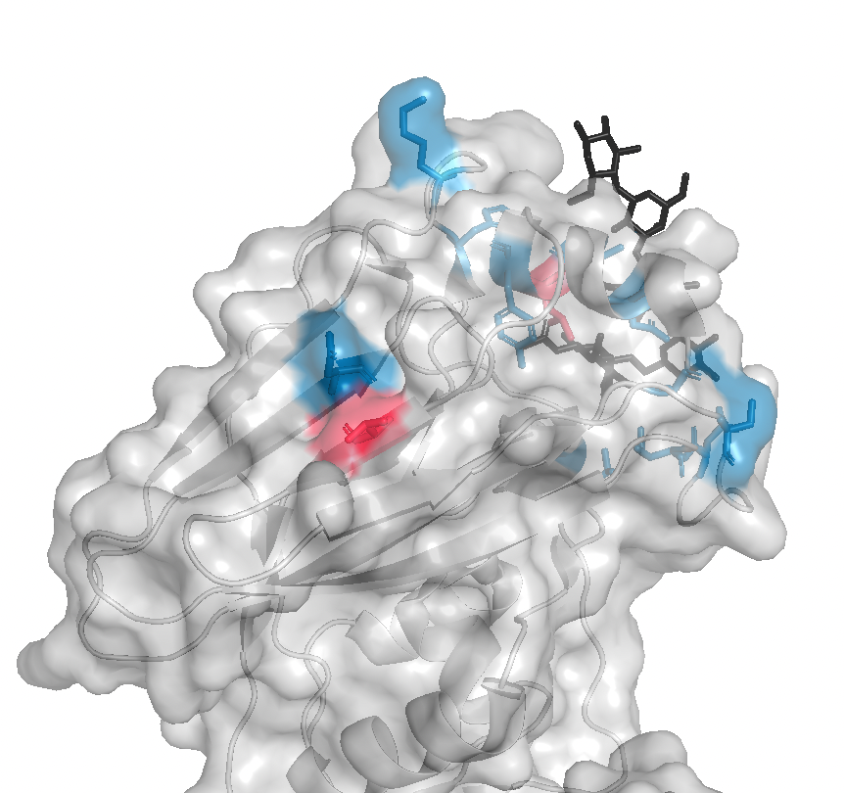
203I only occurs with 194P… any idea why?
194P
203I

Slide 4


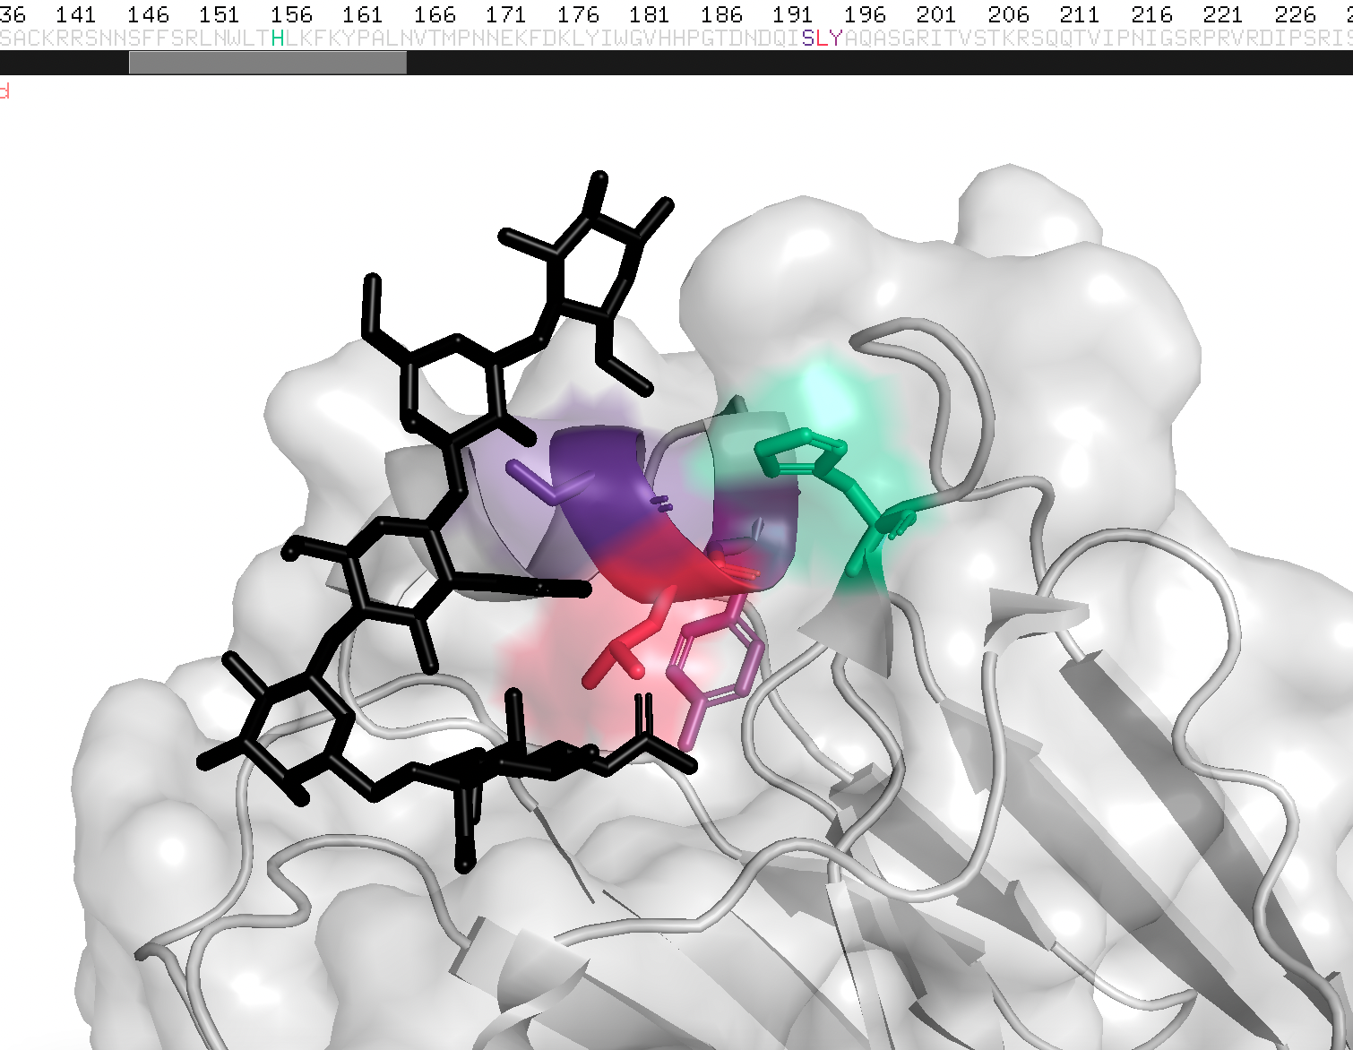
194P only happens on 193F (not S)
194I happens on 193S, but stops happening ~2002/2003, coinciding with a fixation at 155 (and 156). Maybe 194I/155T not compatible?
193R occurs on 193S ~1995-2005, but not 2020-2024
195F fixes in 2020, along with 193S. Maybe 193R/195F not compatible?
(190, 186, 159, 160, 164 also fix right after this)
155 193 195
H S Y
T S Y
T F Y
T S F
193R
194I
193R
194P
195Y
H3n2_epiNetwork.pse (2YP4)

Slide 5
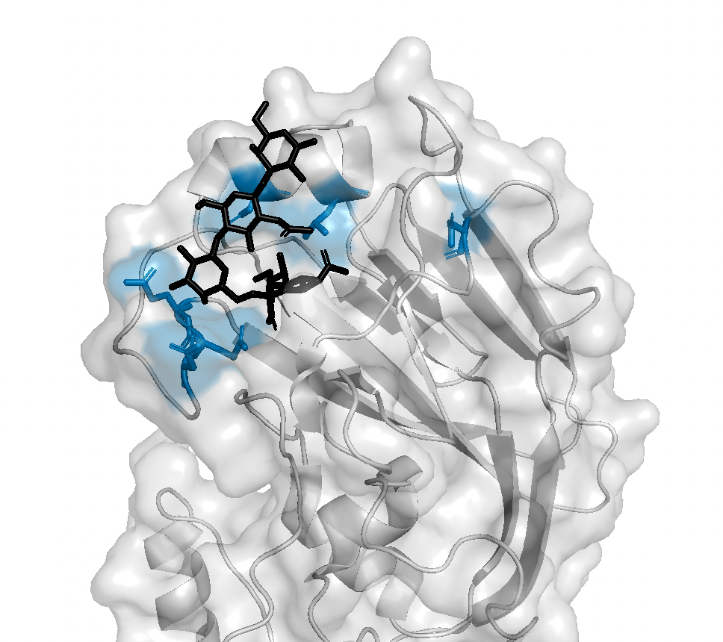
H1N1pdm HA monomer with 2,6-SA analog
All egg-adaptive muts identified surround the receptor binding pocket
h1n1_allAdaptiveMuts.pse (3UBE)

Slide 6
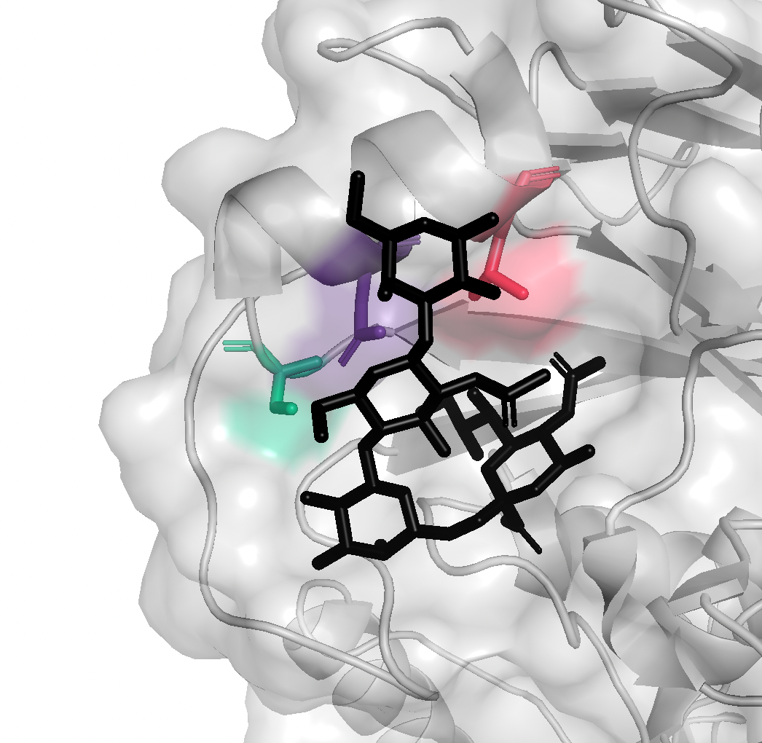
183S
183P
187V
191I
Does is make sense that 183P would change the structure, causing 191 to contact 2,3 SA rather than 187?
- (183P might also be egg-adaptive, not quite sure)

Slide 7
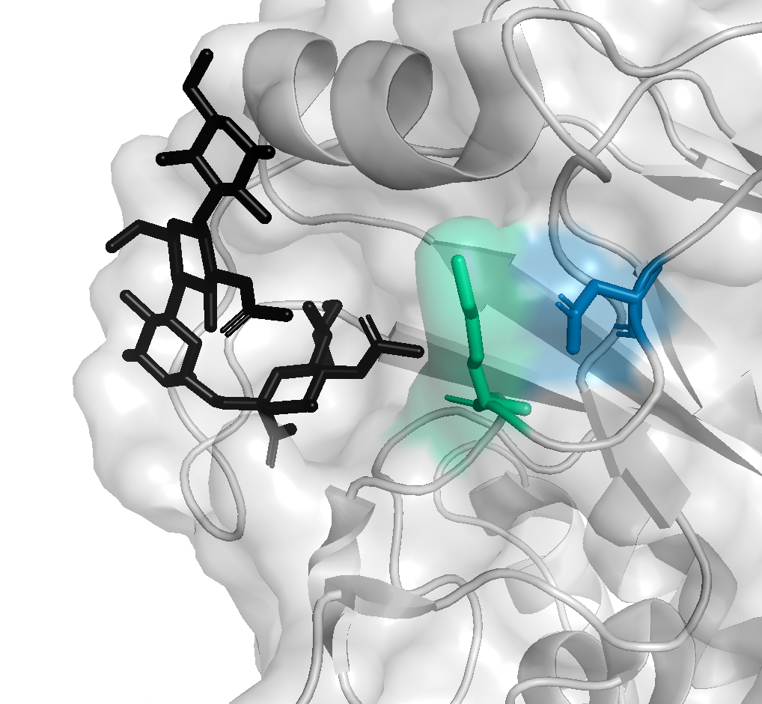
130K
130N
127E
Does this make any sense? Does it seem more likely that 127E is only adaptive in the context of 130K or that 127E cannot happen with 130N?

Slide 8
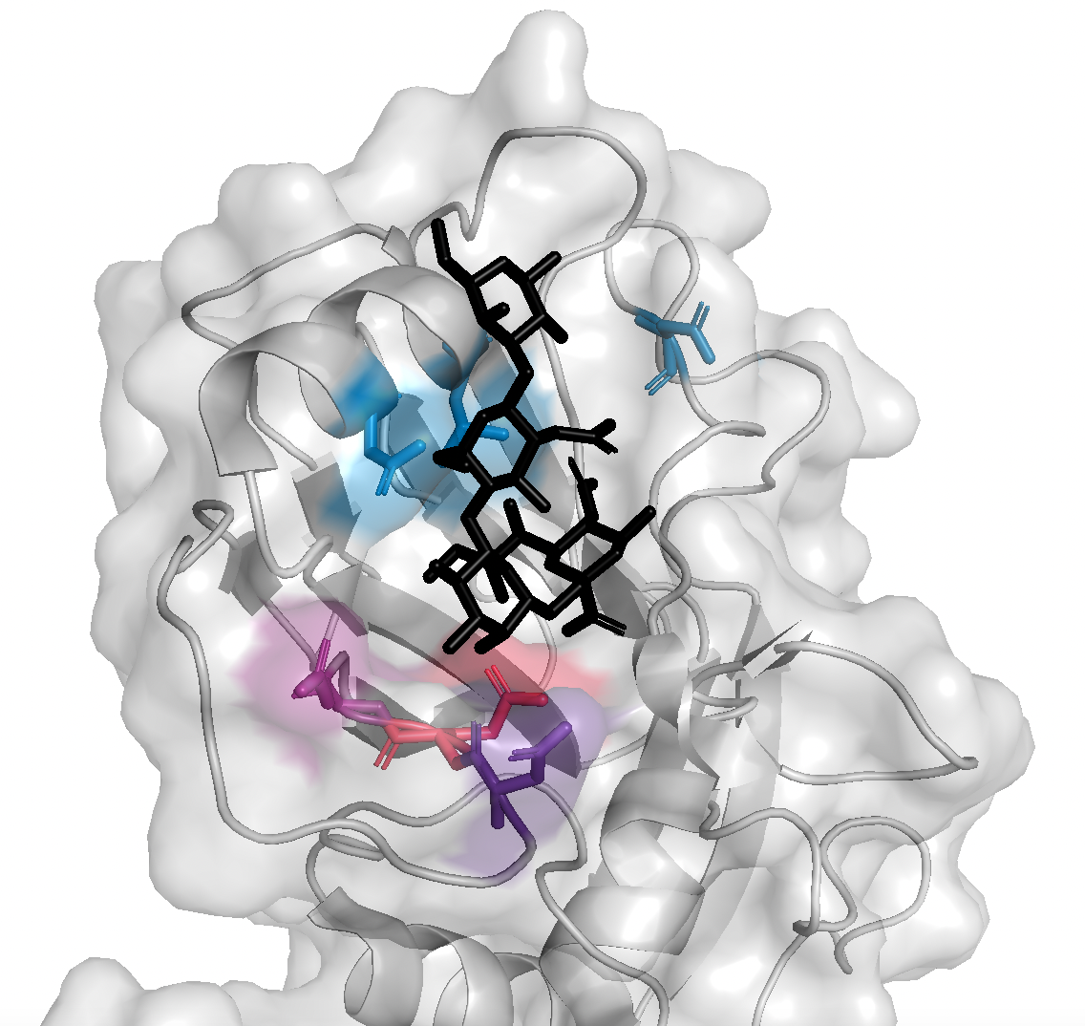
TONS of egg strains get 223R or 222N/G, but only one strain has a mut at both sites (222G+223R)
- Is there a structural reason that these should not co-occur? Or does it indicate that their adaptive effect is redundant (e.g. if strain gets 222G, 223R has no added benefit)
Also, 187, 191 and 127 muts will happen with 222 muts sometimes, but not with 223
224K muts happen only in a small period of time and I can’t quite figure out the correlates (maybe 164 and 189 but 164 doesn’t seem likely)

